Slide 1
Getting Started with Esri Leaflet
Patrick Hammons
phammons@esri.com

Slide 2
Maps on the web

Slide 3
The WebGIS Pattern: Traditional Approach
Step 1: Make a map in ArcGIS Online
Step 2: Refine your styling, get your popups right
Step 3: Share!

Slide 4
Sharing Options
Web map
Story Map
Web Map from a Template
Web App Builder, maybe customize some code
Or…a full fledged custom app using the ArcGIS JS API

Slide 5
Some limitations of the traditional approach
Limited functionality out-of-the-box
Sometimes a challenge embedding with certain CMS’s
Relies on the full ArcGIS Javascript API
SUPER POWERFUL
All that power comes at a cost
Not the go-to approach for non-GIS crowd

Slide 6
What is Leaflet?

Slide 7
Leaflet is
The leading open-source Javascript Library for mobile-friendly interactive maps

Slide 8
Leaflet
Open source javascript mapping library
Focused on a very small library (37kb)
Simple, clear, extensible API
Huge plugin ecosystem + community of developers

Slide 9
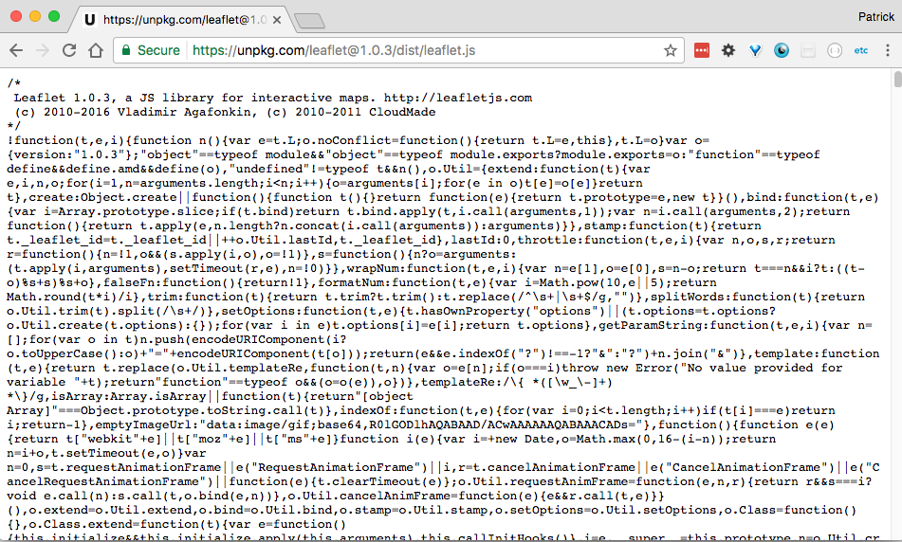
So small!
Only 37kb!

Slide 10
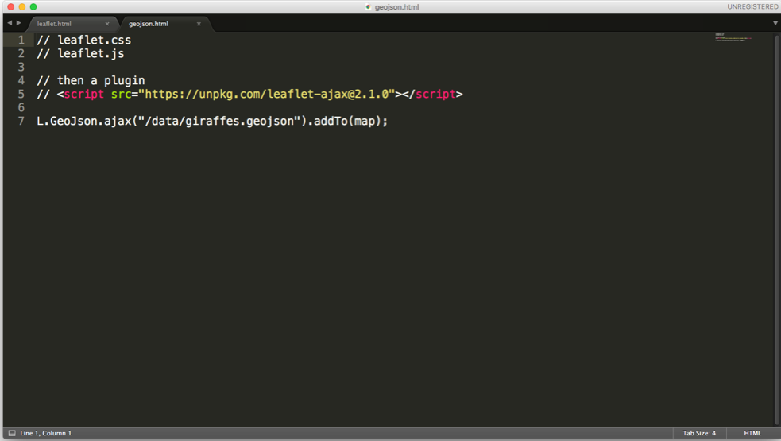
But also…so small
that it doesn’t help you load .geojson

Slide 11
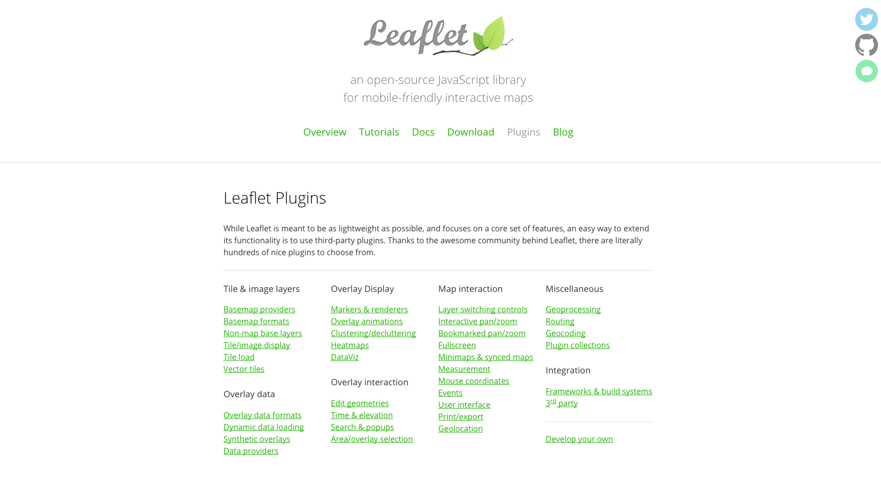
Plugins!
Adding functionality as you need it

Slide 12
What is Esri Leaflet?

Slide 13
Esri Leaflet is
A collection of plugins that make working with the most popular ArcGIS Services a pleasure

Slide 14
Esri Leaflet Overview
Entirely open source, with 50+ contributors
Different than a lot of Esri products (no roadmap, no lifecycle)
Provides small components for only some of the ArcGIS platform
Not a replacement for the ArcGIS API for Javascript
Opens up ArcGIS resources and data to non-traditional GIS types (e.g. web developers)

Slide 15
Ok let’s get at it!

Slide 16
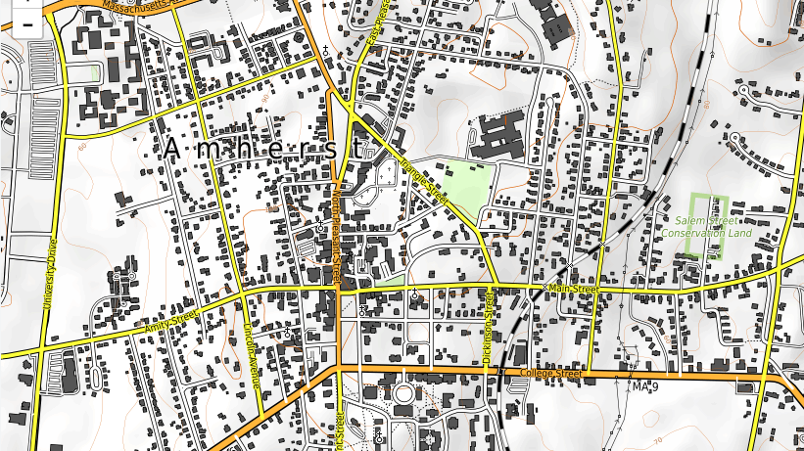
Basic Leaflet Map
http://bit.ly/Leaflet-1

Slide 17
Exercise 1:
http://bit.ly/Leaflet-1
To do:
Set map to center on Amherst, determine a good zoom level
Choose a basemap
Resources:
Leaflet docs: http://bit.ly/LeafletExamples
Esri Leaflet docs http://bit.ly/EsriLeafletExamples

Slide 18
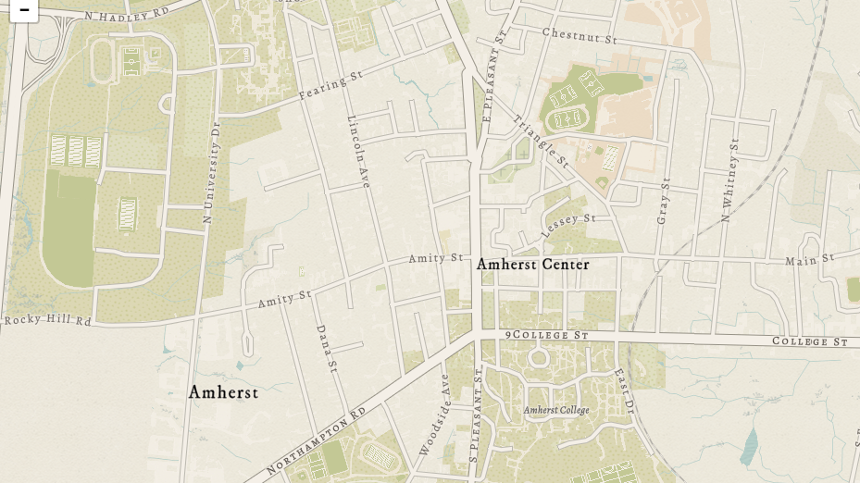
Vector Basemaps
http://bit.ly/Leaflet-2

Slide 19
Exercise 2:
http://bit.ly/Leaflet-2
To do:
Add Esri Leaflet Plugin
Add Esri Leaflet Vector Plugin
Change the basemap to a vector basemap
Resources
Leaflet docs: http://bit.ly/LeafletExamples
Esri Leaflet docs http://bit.ly/EsriLeafletExamples

Slide 20
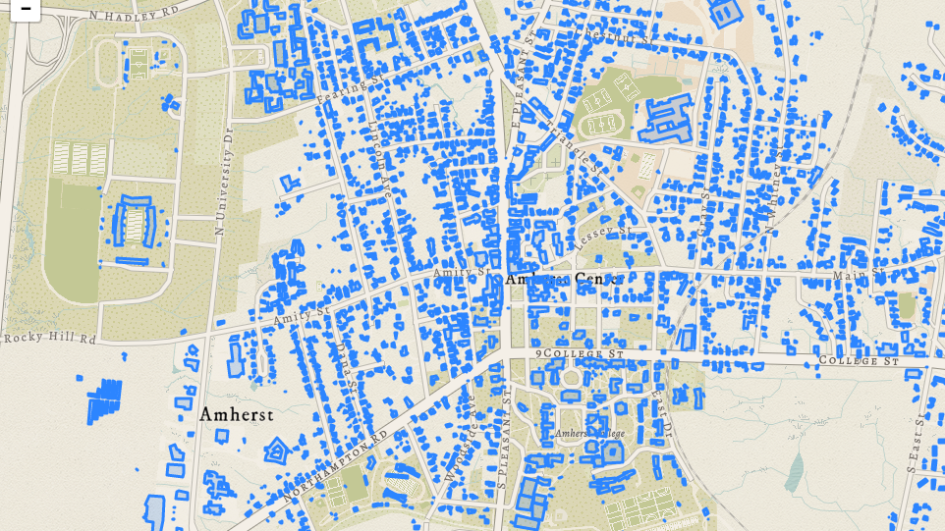
Adding Data
http://bit.ly/Leaflet-3

Slide 21
Exercise 3:
http://bit.ly/Leaflet-3
To do:
Find some data in Amherst from http://opendata.arcgis.com
Map the data, keeping default styling for now
Resources
Leaflet docs: http://bit.ly/LeafletExamples
Esri Leaflet docs http://bit.ly/EsriLeafletExamples

Slide 22
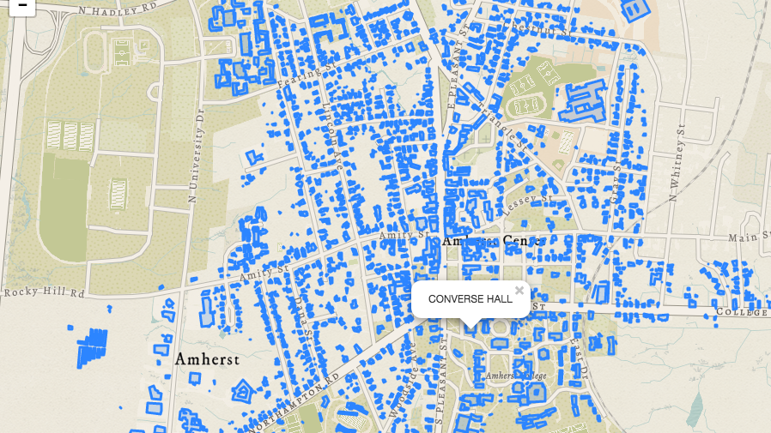
Popups
http://bit.ly/Leaflet-4

Slide 23
Exercise 4:
http://bit.ly/Leaflet-4
To do:
Visit Esri Leaflet docs section on popups
Return the NAME property of the given dataset
Resources
Leaflet docs: http://bit.ly/LeafletExamples
Esri Leaflet docs http://bit.ly/EsriLeafletExamples

Slide 24
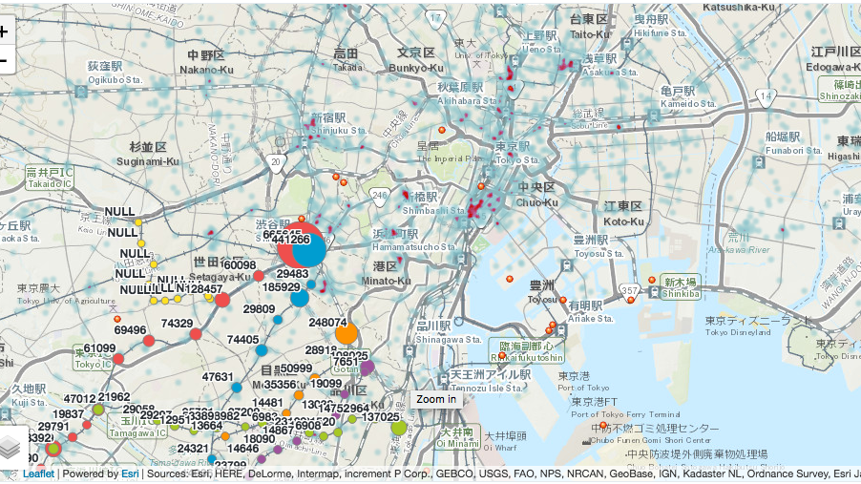
Choose your own adventure!
http://esri.github.io/esri-leaflet/examples/

Slide 25
Exercise 4:
http://bit.ly/Leaflet-4
Choose an example from the workflow and go at it!
Ideas
Styling points, lines, or polygons
Label features using permanent tooltips
Run some spatial queries
Explore a plugin from the Esri Leaflet docs

Slide 26
Quick wrap up!

Slide 27
Quick Wrap Up!
Esri Leaflet vs. ArcGIS JS API
Good developers choose the right tools for the project
What you use should be based on your needs

Slide 28
Choose Esri Leaflet if you…
Are integrating into existing apps
Are already using Leaflet
Want a more stripped-down, focused toolset
Want to leverage ArcGIS and non-ArcGIS Services or data in the same app
Want to leverage Leaflet Plugins

Slide 29
Choose ArcGIS API for Javascript if you…
Want a framework
Need deep integration with ArcGIS
Want to support EVERYTHING (renderers, webmaps, etc.)
Need to support non-web-mercator projections
Really love Dojo

